Slide 1



M/s. Mother India Life Spaces and Infra Engineering Limited, INDIA.
(Deals in Exports: All Agricultural Food Products, FMCG., Construction Materials)
The Reverse Buyer – Seller Meet (RBSM)
On dated: 18.02.2025 & 19.02.2025
At: Venue: Hotel Radisson Blu Resorts, Visakhapatnam.

Slide 2
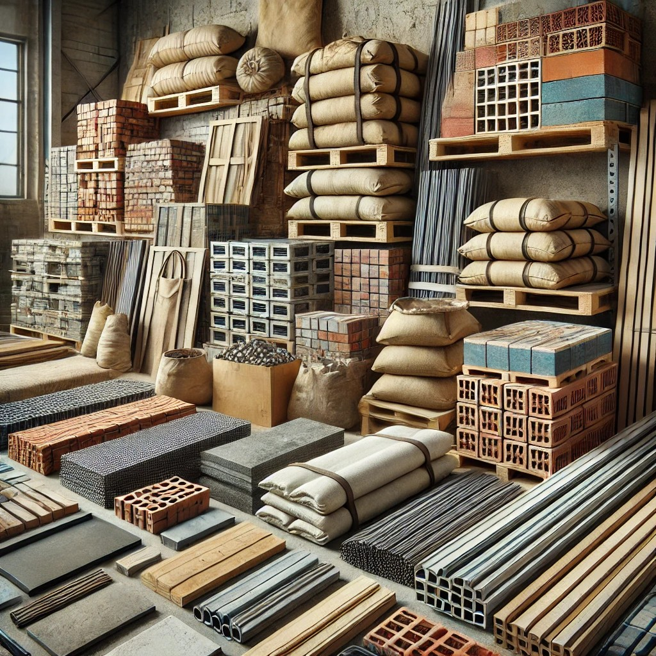
Construction Materials
The Importance of Construction Materials in Building and Infrastructure
Construction materials play a vital role in the development of buildings, roads, bridges, and other infrastructure projects. The quality, durability, and sustainability of these materials determine the strength and longevity of structures. From ancient civilizations to modern skyscrapers, construction materials have evolved significantly to meet the demands of engineering, safety, and environmental sustainability.

Slide 3
Types of Construction Materials
Construction materials are broadly categorized into
1. Natural Construction Materials
2. Traditional Building Materials
3. Modern and Innovative Materials

Slide 4
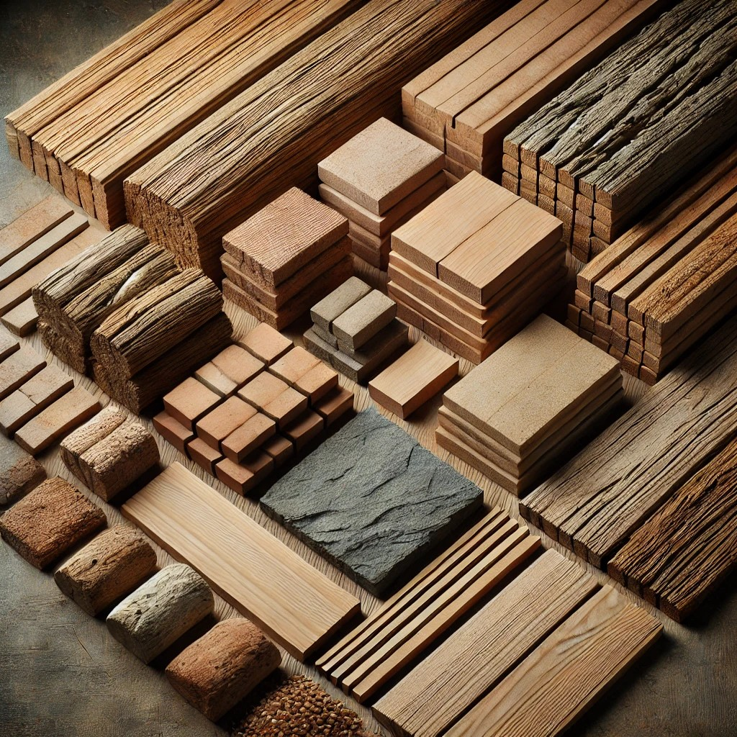
Natural Materials
Wood: A renewable and versatile material used for structural frameworks, furniture, and decorative elements.
Stone: One of the oldest construction materials, commonly used for foundations, walls, and flooring.
Clay: Used in the production of bricks and ceramics, offering durability and insulation properties.

Slide 5
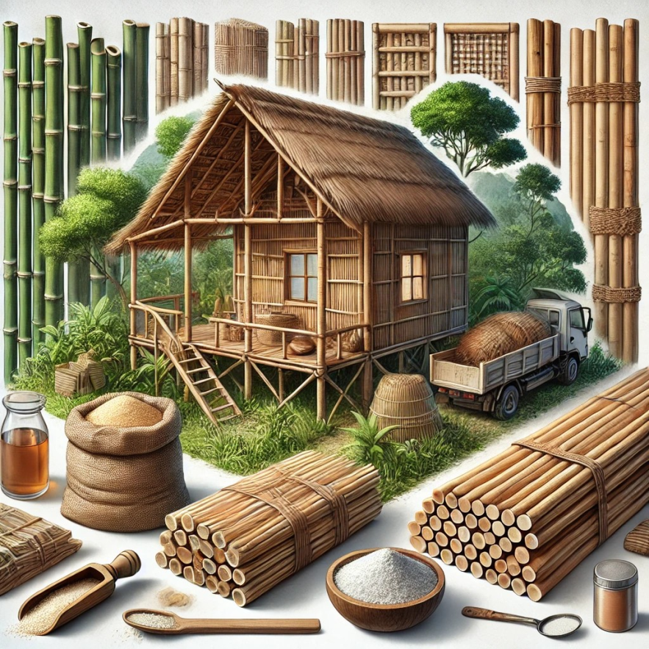
Natural Materials
  Bamboo: A highly sustainable material used for scaffolding, flooring, and structural elements, particularly in tropical regions.
  Thatch: A roofing material made from dried plant stalks, such as straw or reeds, used in traditional and eco-friendly constructions.
  Lime: Used in mortar and plaster, lime is an ancient construction material known for its durability and breathability.

Slide 6
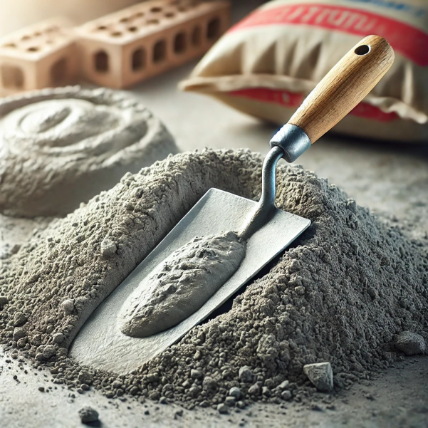
2. Traditional Building Materials
(i). Cement
Cement is one of the most widely used building materials in the Construction industry to construct almost every type of structure.
Cement is used in the construction for the various purpose such as making mortar ( cement + sand ) which is used in the plastering work and structure of the brickwork, for making concrete ( cement + sand + aggregates) which is used in the construction of the slabs, columns, and footings, etc.
There are also various types of cement that are used for multiple purposes and in different conditions.
1. Ordinary Portland Cement.
2. Rapid Hardening Cement.
3. High Alumina Cement.
4. Blast Furnace Slag.
5. Pozzolana Cement.
6. Air Entraining Cement.
7. Expansive Cement.
8. Colored Cement.
9. Sulfate Resisting Cement.
10. Low Heat Cement.
11. White Cement.
The above are the various types of cement used to construct multiple structures such as dams, bridges, high-rise buildings, etc.

Slide 7
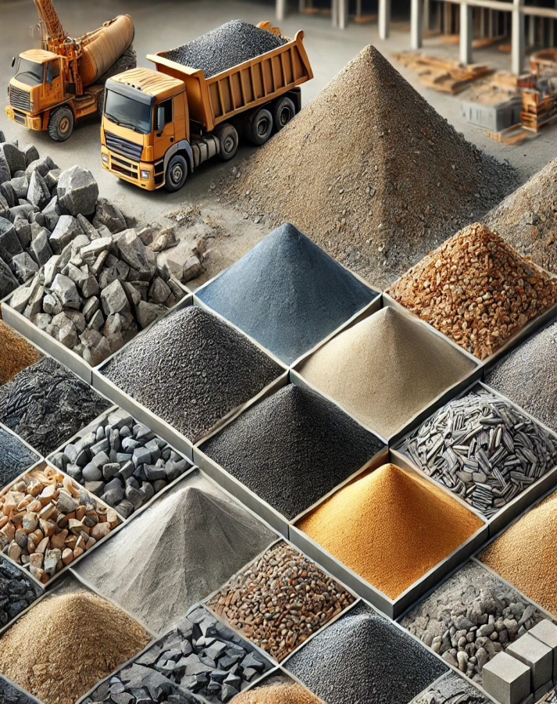
(2). Aggregates
Aggregates are also the most commonly used building materials in the construction Industry. Aggregates are mainly used in the manufacturing of concrete.
Aggregates give volume to the concrete and make it economical. It is a central component in the concrete. Aggregates have High conductivity so that it is widely used in the drainage applications such as the construction of the foundation, septic drain fields and another type of the drainage works.
The aggregates are available in various sizes and are mainly classified into two types that are coarse aggregates and fine aggregates.

Slide 8
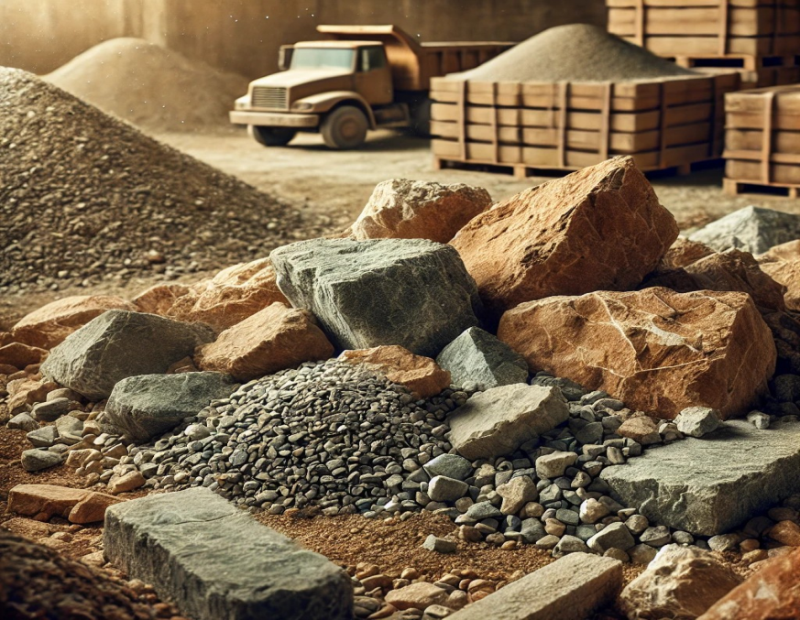
3. Stones and Rocks
Rocks are the naturally found building material that is generally used in the construction of various structures. The stones and rocks used in the construction are hard, durable, tough, and free from the weathered soft patches of the materials.
The stones should also be free from any kind of cracks as it will reduce the strength and Durability of the rocks.
There are different types of rocks that are used in the construction that are as follows
Ballast.
Granite.
Sandstone.
Slate.
Laterite.
Limestone.
Marble.

Slide 9
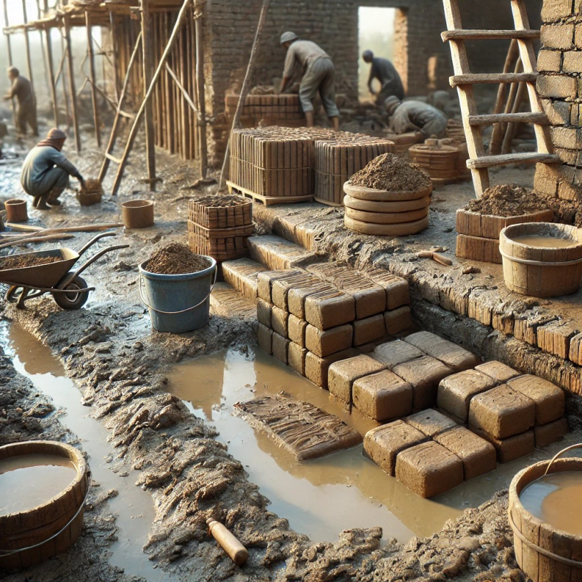
4. Mud and Clay
Mud is a mixture of soil, silt, loam, clay, and water. The Mud generally formed by the natural process after the rainfall. After the Mud gets hard and formed a stone-like structure which is also known as Mudstone.
Mud is a type of construction material that is in a semi-fluid state. Mus is mainly used to seal, coat, and adhere to the materials. Clay is a finely-grained soil formed due to the slow effect of weathering and erosion of rocks.
Mud and clay are used for the mud plaster in the rural areas for both interiors and the exterior of the houses. It is a very cheap building material used in the construction of houses in rural areas.

Slide 10
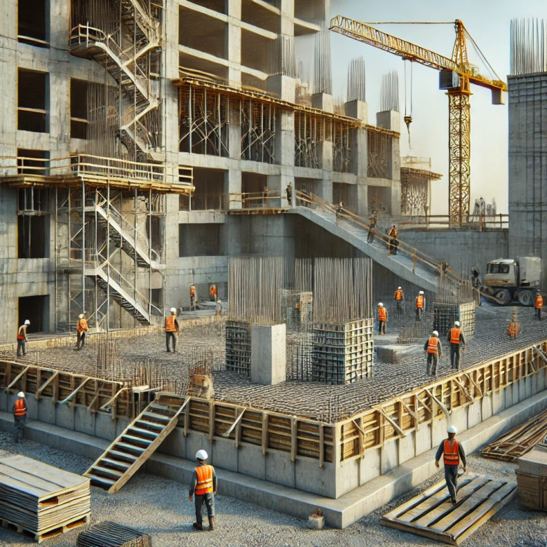
5. Concrete
Concrete is a composite building material made from a combination of cement, sand, aggregate, and water in appropriate proportion. The concrete is used for the construction of the columns, foundations, beams, slabs, etc.
Concrete is prepared with various types of grades, and the grade of the concrete denotes strength of the concrete.
Concrete is mainly used for two types of construction such plain cement concrete construction and Reinforced cement concrete construction.

Slide 11
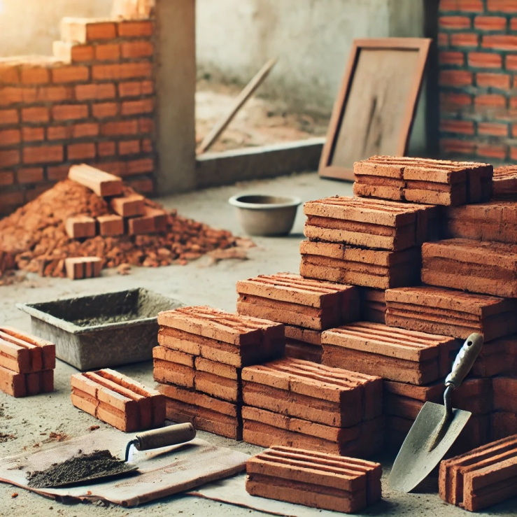
6. Bricks
Bricks are one of the oldest building materials used in the construction of various structures. The Bricks are one of the most commonly used building units. Bricks are mainly used for the construction of walls and paving. They are easy to handle, strong in compression, and also durable.
There are also various types of bricks nowadays are available in the market, such as Clay bricks, concrete bricks, engineering bricks, and sand-lime bricks, etc. Bricks are typically made from clay, and it is also an economical building material used in the construction of buildings.

Slide 12

Sand
Sand is a naturally occurring granular material composed of finely divided rock and mineral particles. It is typically made up of quartz, feldspar, and other minerals, giving it different colors and textures depending on its origin. Sand is commonly found in deserts, beaches, riverbeds, and underwater deposits.
Characteristics of Sand:
Particle Size: Ranges from 0.0625 mm to 2 mm in diameter.
Composition: Mostly silicon dioxide (SiO₂) in the form of quartz, but may also contain calcium carbonate, gypsum, or volcanic ash.
Texture: Rough or smooth, depending on erosion and environmental conditions.
Color: Varies from white, yellow, red, black, or even green, depending on mineral content.
Porosity: Allows water and air to pass through easily.
Types of Sand:
Desert Sand: Fine, rounded, and often unsuitable for construction.
Beach Sand: Contains salt and organic materials; used for recreational and landscaping purposes.
River Sand: Coarse and angular, making it ideal for construction.
Manufactured Sand (M-Sand): Artificially made by crushing rocks; used as a substitute for river sand in construction.
Volcanic Sand

Slide 13
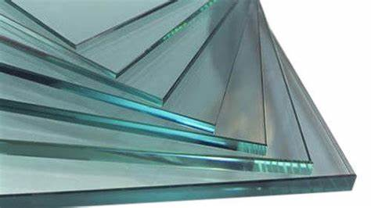

7. Glass
Glass is also a commonly used building material for various architectural purposes. It is used as a glazing building material in the building envelope. Glass is a product that is made from a mixture of sand and silicates in an extremely hot kiln.
Glass is used in the windows mainly to cover the panel of the window so that light enters the room.
The different types of Glass that are used in the construction are as follows.
Following are the types of Glass which are used in construction
Float Glass.
Tinted Glass.
Extra Clean Glass.
Double Glazed Glass.
Chromatic Glass.
Glass Wool.
Glass Blocks.
Toughened Glass.
Laminated Glass.
Shatterproof Glass.

Slide 14
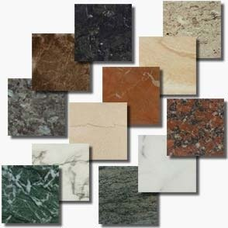
8. Granite
Indian granite is a durable, attractive, and affordable stone that comes in many colors and varieties. It's used for construction and decoration around the world.
Uses of Granite:
Construction, Countertops, Flooring & Tiles, Sculptures & Monuments, Paving & Landscaping
Types of Granite:
White Granite, Black Granite, Brown, Pink/Red Granite, Green Granite, Blue Granite

Slide 15

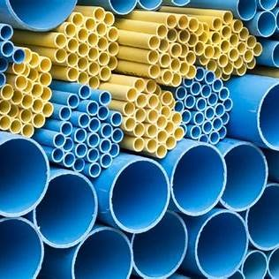
9. Plastic
Plastics are used in a growing range of building and construction applications, including insulation, piping, window frames and interior design.
The properties of plastic, which the construction professionals generally consider are as follows.
Cost-Effectiveness, Energy Saving, Safety, Easy to Install, Appearance, Chemical resistance, Dimensional stability, Ductility, Durability, Electric insulation, Finishing, Fire resistance, Fixing, Humidity, Maintenance, Melting point, Recycling, Strength

Slide 16
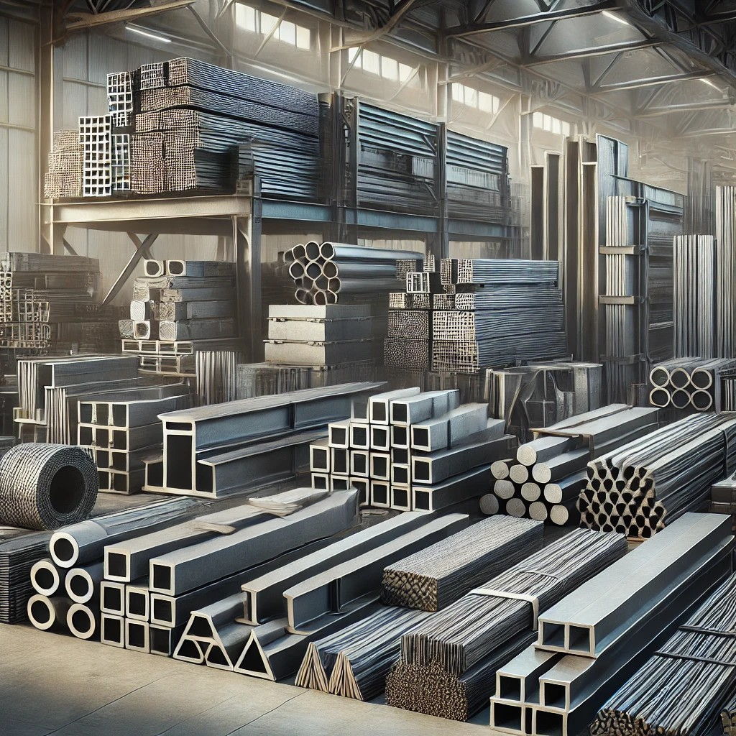
10. Steel
Steel is also widely used nowadays in the construction of various structures. Structural steel is used for the construction of steel structures. Steel is becoming the building material of choice for many large construction companies and contractors because of its various benefits.
Steel is durable and can withstand high external pressures such as earthquakes, thunderstorms, and cyclones. A well-designed and constructed steel structure can last up to 30 years if maintained well.

Slide 17
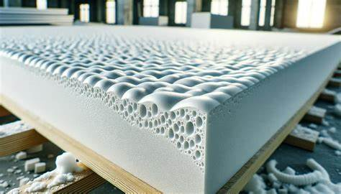
11.Foam
Foam is a lightweight, versatile construction material used in various applications, including insulation, soundproofing, and structural components. Here are some common types of construction foam:
Types of Construction Foam
Polystyrene Foam (EPS & XPS)
  EPS (Expanded Polystyrene): Lightweight, used for insulation and packaging.
  XPS (Extruded Polystyrene): Denser, water-resistant, used in foundation insulation.
Polyurethane Foam (PU Foam)
  High thermal insulation properties.
  Used in spray insulation, sealants, and structural panels.
Polyethylene Foam
  Durable and flexible.
  Used for soundproofing and shock absorption.
Phenolic Foam
  Fire-resistant and high thermal efficiency.
  Used in HVAC ducts and industrial insulation.

Slide 18
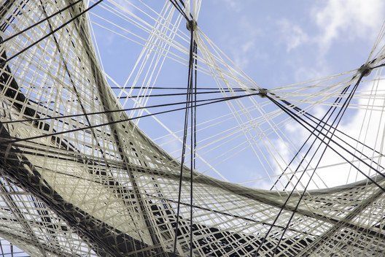
12. Fabric
Fabric structures are forms of constructed fibers that provide end users a variety of aesthetic free-form building designs. Tensile structures are lightweight, strong, durable systems that offer architects formal flexibility in ways other building materials cannot.
The qualities of fabric consist of the diffusion of light, acoustic dampening, and the ability to span large areas uninterrupted. Custom-made fabric structures are engineered and fabricated to meet worldwide structural, flame retardant, weather-resistant, and natural force requirements. Fabric structures are considered a sub-category of tensile structure.

Slide 19
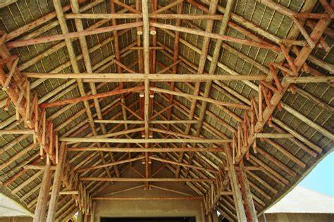
13. Thatch
With the help of dry vegetation such as straw, water reed, sedge, rushes, heather, or palm branches roof of the building is crafted is known as the thatching.
Due to thatching, the shaded water does not come to the inner roof. Due to densely packed vegetation is used for the thatching it works as insulation. Thatched is also used in the construction of modern roofs that are known as Thatched roofs.

Slide 20
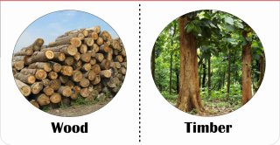
14. Timber and Wood
Timber is also popularly used in the form of plywood & raw wood. Products like ply blocks and ply boards. Heavy patterned doors and windows are made of solid wood/Timber to provide strength, toughness, and durability. Teakwood is a most appropriate timber to be used in the construction of buildings.
Timber is the type of wood which is also used for construction or carpentry and furniture purposes. Timber is a material which is been used in construction since ancient times.
Wood fabricated in different types of shapes and sizes. Timber provided good strength, toughness, durability. Wood is a naturally available material. Wood is a good isolation material.

Slide 21
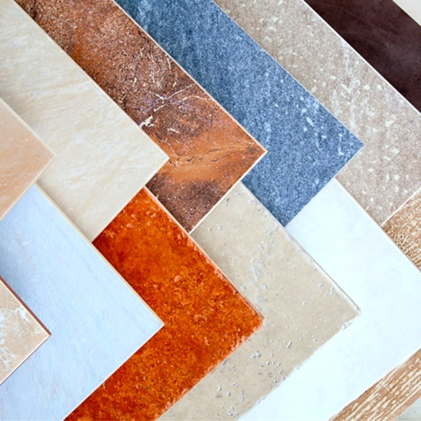
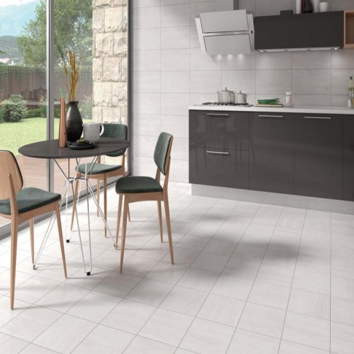
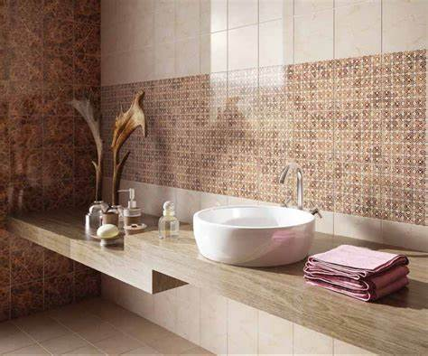
15. Tiles (Ceramics)
Tiles are widely used for flooring in kitchen, bathrooms, parking lots, rooftops and also used as tabletops for dining rooms. Tiles are made from materials like ceramic, porcelain, glass, stone or metal. We can use tiles for any decorating style, as they are available in a number of sizes, shapes, colors, and textures.
Tiles are mostly preferred nowadays compared to granite because of its advantages like stain and scratch resistance, low maintenance, easy to install, and don’t fade when exposed to sunlight or high or low temperatures.

Slide 22
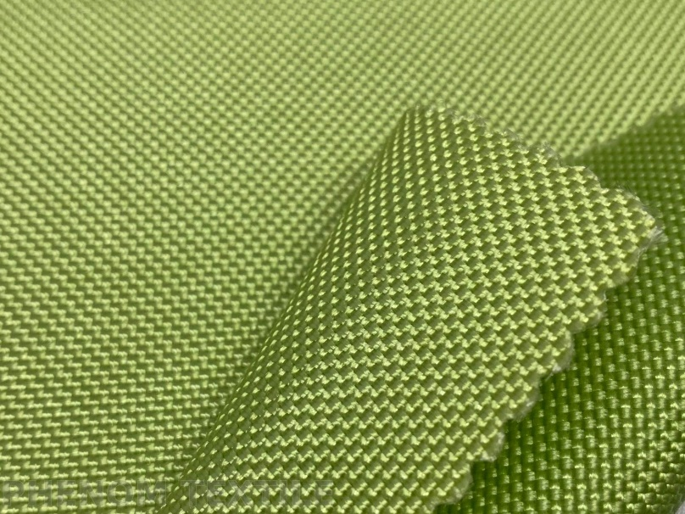
16. Kevlar
In building construction, Kevlar can be formed into a sheet material for roofing, cladding and reinforcing. It was used unsuccessfully on the roof of the Olympic Stadium in Montreal which only lasted 10 years before it had to be renewed.
It can be used to protect bank counters and reinforce seismic shear walls. However, it can be problematic to install and when used structurally, the structural calculations can be difficult. It is also very expensive.

Slide 23
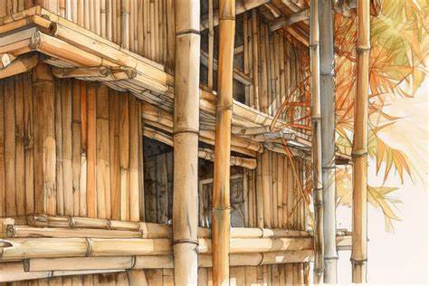
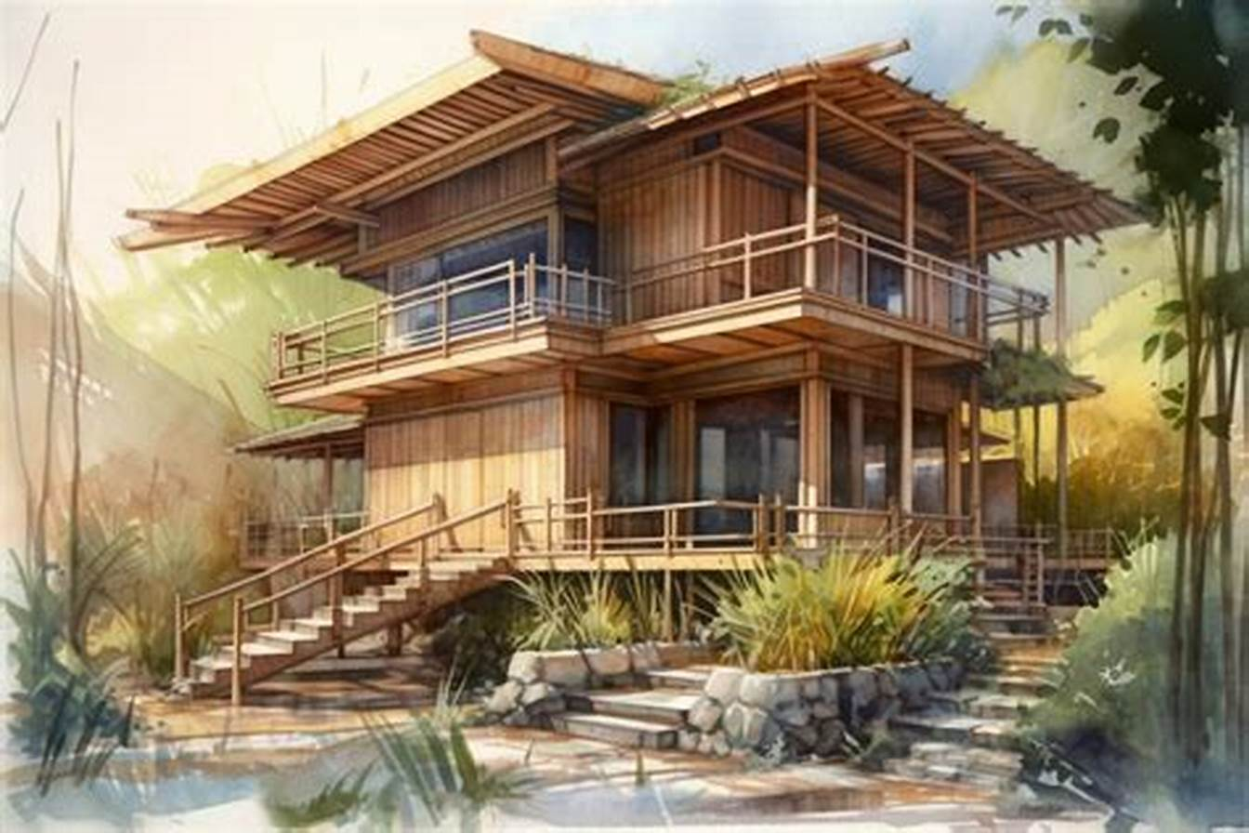
17. Bamboo
Bamboo is a versatile material, used to make paper and bedsheets. It is also strong enough to use as scaffolding for skyscrapers and has a long history of use in vertical construction.
In addition, the material is in demand as flooring and decorative elements due to its biophilic design aesthetic.

Slide 24
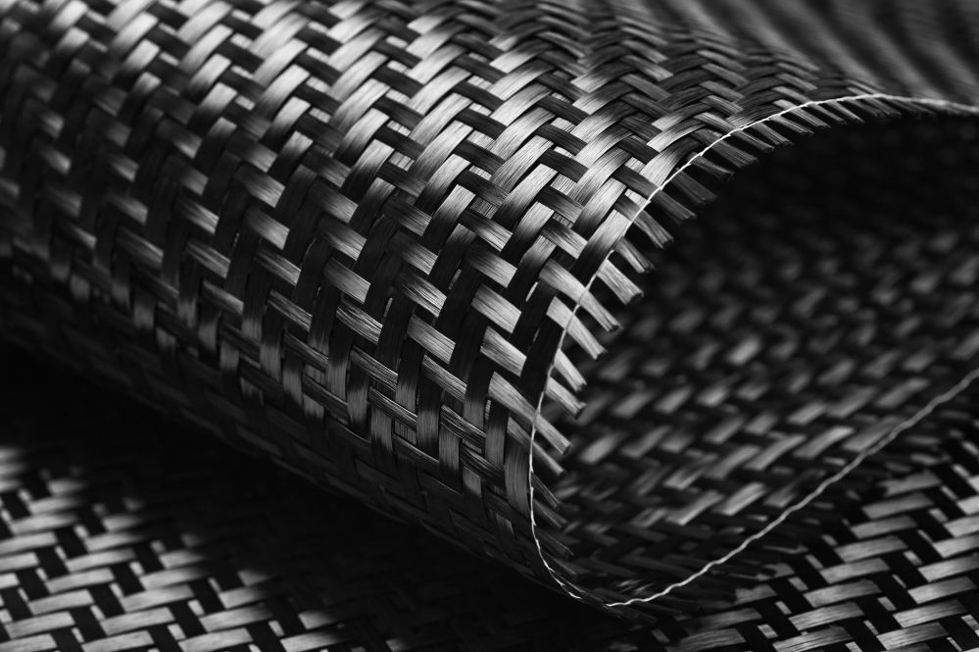
18. Carbon Fiber
Carbon fiber has low thermal conductivity and provides good cohesion when used with concrete, which can be beneficial for high loaded floors and roads. It is also five times stronger than steel, while weighs just one-third of it, and has a much higher load bearing capacity.
This helps in the easy delivery of carbon fiber wraps at the construction location as well as makes installation simpler, which reduces the overall timeline of a project. Carbon fiber can be used as a replacement for asbestos in fiber cement as it does not create any inhalation issues.

Slide 25

19. Electrical Items
Electrical equipment includes any machine powered by electricity. It usually consists of an enclosure, a variety of electrical components, and often a power switch. IT equipment (computers, printers etc.) Motors, pumps and HVAC Systems.

Slide 26
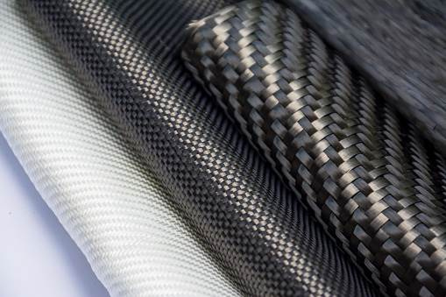
20. Composites
Composites are materials consisting of two or more chemically distinct constituents on a macro-scale, having a distinct interface separating them, and with properties which cannot be obtained by any constituent working individually.
There are three major types of composites
1. Polymer Matrix Composite (PMCs)
2. Metal Matrix Composite (MMCs)
3. Ceramic Matrix Composite (CMCs)

Slide 27



Ramprasad GVSS.,
Founder & MD.,
📞 +91 7386112277,
✉️ Email: cmd@motherindgroup.com | ramprawsadindia@gmail.com
🌐 Website: www.motherindiagroup.com

